Slide 1
Local Area Network (LAN)
A local area network (LAN) is a group of computers and associated devices that share a common communications line or wireless link to a server.
LAN connects network devices over a relatively short distance.
In TCP/IP networking, a LAN is often but not always implemented as a single IP subnet.
LANs are also typically owned, controlled, and managed by a single person or organization.
Ethernet and Token ring are primarily used in LAN.

Slide 2
Wireless LAN (WLAN)
WLAN allows a mobile user to connect to a local server using radio connection.
IEEE 802.11
Uses Ethernet protocol and CSMA/CA

Slide 3
Bluetooth
It is a wireless technology standard for exchanging data over short distances from fixed or mobile devices.
Uses short wave UHF radio waves (2.4 to 2.485 GHz)
Used in building personal area network (PAN)
Bandwidth of around 800 Kbps
Low cost
Range of approx 100 meters or 328 feet

Slide 4
PABX
Private Automatic Branch Exchange
Automatic telephone switching system within a private enterprise.
Originally, such systems - called private branch exchanges (PBX) - required the use of a live operator.

Slide 5
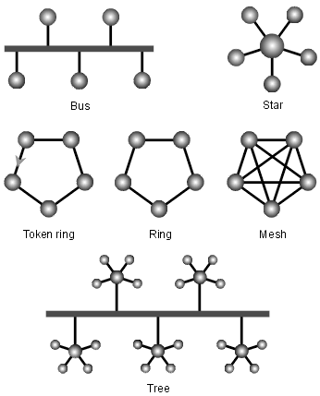
Network Topology
Topological structure of a network and may be depicted physically or logically.
It is the arrangement of various elements of computer network
There are two ways of defining network geometry : the physical topology and the logical topology (signal topology)

Slide 6
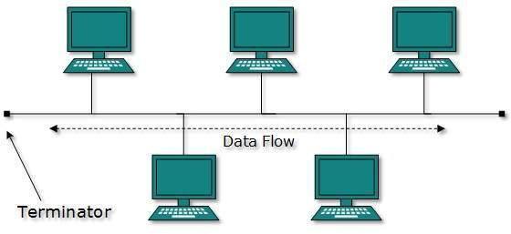
Bus Topology
A bus network is a network topology in which nodes are directly connected to a common linear (or branched) half-duplex link called a bus.

Slide 7
Advantages/Disadvantages of Bus Topology
Advantages:
Works well for a small network
Easiest topology to design
Requires less cable length
Disadvantages:
Difficult to identify problem if the whole network goes down.
Not suitable for large network.
Additional devices slow the network down.
If a main cable is damaged, the network fails or splits into two.

Slide 8
Ring Topology
Computer network configuration where the devices are connected to each other in a circular shape.
Each packet is sent around the ring until it reaches its final destination.
Used in both LAN and WAN.
Data flows in one direction to avoid collision.

Slide 9
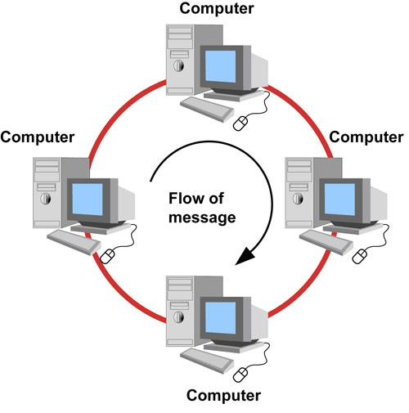
Ring Topology

Slide 10
Pros and Cons of Ring Topology
Advantages:
Avoid data collision.
Server is not needed to control network connectivity between each workstation.
Additional workstations can be added without impacting the network performance.
Cons:
Slower than star topology as all data must pass through each workstation.
Entire network will be impacted if one workstation shuts down.

Slide 11
Star Topology
Every node connects to a central network device, like hub, switch or computer.
The central device acts as a Server.
Other peripheral devices are Clients.
Most commonly used topology.

Slide 12
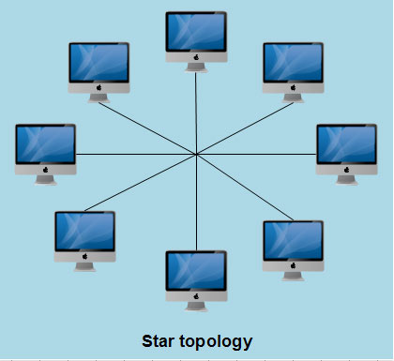
Star Topology

Slide 13
Pros and Cons
Pros:
Centralized management of the network, through the use of the central computer, hub, or switch.
Easy to add another computer to the network.
If one computer on the network fails, the rest of the network continues to function normally.
Cons:
Can have a higher cost to implement, especially when using a switch or router as the central network device.
The central network device determines the performance and number of nodes the network can handle.
If the central computer, hub, or switch fails, the entire network goes down and all computers are disconnected from the network.

Slide 14
Hybrid Topology
A hybrid topology is a type of network topology that uses two or more other network topologies, including bus topology, mesh topology, ring topology, star topology, and tree topology.

Slide 15
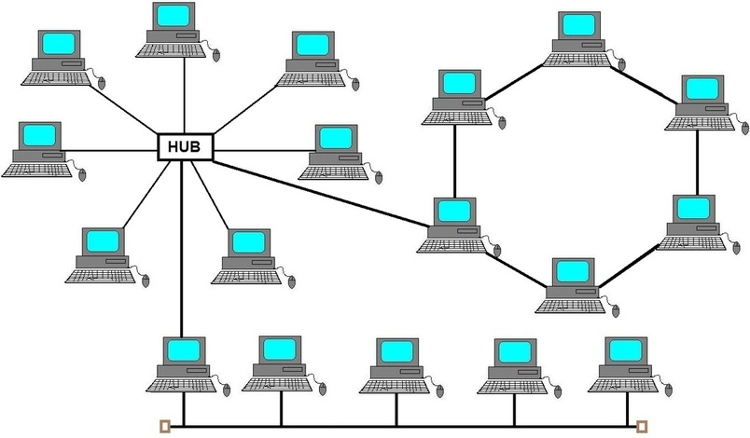
Hybrid Topology

Slide 16
Mesh Topology
A network setup where each computer and network device is interconnected with one another.
Allows most transmissions to be distributed, even if one of the connections go down.
It is difficult and expensive to have redundant connection to every computer.
Commonly used in wireless network.
Full Mesh :every computer in the network has a connection to each of the other computers in that network.
Partial Mesh: at least two of the computers in the network have connections to multiple other computers in that network.

Slide 17
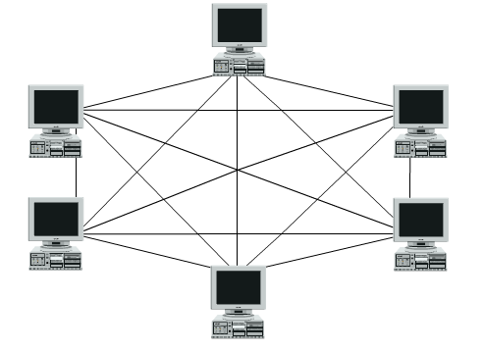
Mesh Topology

Slide 18
WAN
A wide area network (WAN) is a geographically distributed private telecommunications network that interconnects multiple local area networks (LANS).
WAN connections can include wired and wireless technologies.
WAN infrastructure may be privately owned or leased as a service from a third-party service provider, such as a telecommunication carrier, internet service provider, private IP network operator or cable company.

Slide 19
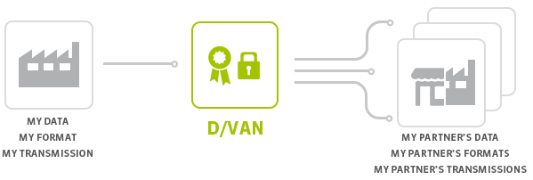
VAN (Value Added Network)
A private network provider hired by a company to facilitate electronic data interchange (EDI) and/or provide other network services such as message encryption, secure email and management reporting.

Slide 20
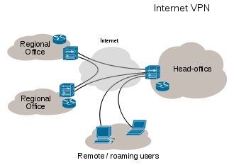
VPN (Virtual Private Network)
It is a network that is constructed using public wires — usually the Internet — to connect to a private network, such as a company's internal network.
A VPN client on one computer connects to a VPN server on another computer and by using encryption.
It is cost effective.

Slide 21
Circuit Switching
Primarily used in Telephone network.
End to End circuit (path) is first reserved using a separate signaling protocol.
Data transfer proceeds only after the path is established.
All data of that session passes through the same circuit
No other user can use this circuit till this session is completed
No signaling information is sent along with the data
Circuit is released after data transfer using the signaling protocol

Slide 22
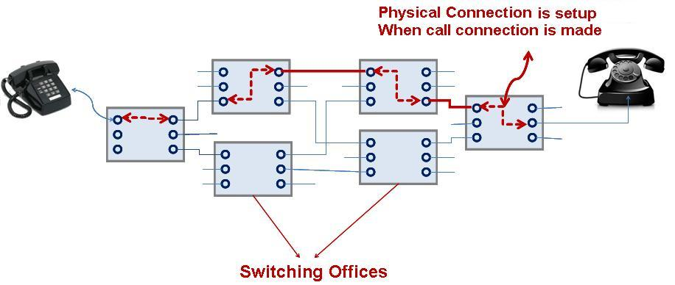
Overview Circuit Switching

Slide 23
Packet Switching
Refers to protocol where messages are divided into packets before transmission.
Each packet is transmitted independently & can follow different route to its destination.
Once all packets are received, they are recompiled to form the original messages.
WAN, TCP-IP, Frame-relay etc. are based on packets switching.
It is mostly used for transmitting data that can withstand delay such as e-mail msgs and webpages

Slide 24
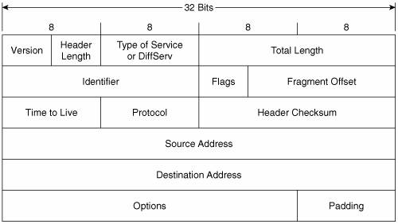
Packet Header Format

Slide 25
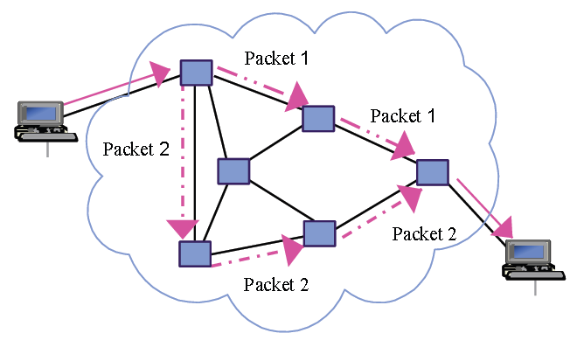
Packet Switching Network

Slide 26
Frame Relay
Frame relay is a packet switching technology for connecting network points in WAN.
It is connection oriented data service and establish virtual circuit between end points.
In order for a frame relay WAN to transmit data, data terminal equipment (DTE) and data circuit-terminating equipment (DCE) are required.
Frame relay transmits packets at the data link layer of the Open Systems Interconnection OSI model.
Frame relay does not perform error correction.
It can communicate at transmission speed of 1.54 Mbps (max 45Mbps)

Slide 27
Fiber Distributed Data Interface
FDDI is a set of ANSI and ISO standards for data transmission on fiber optic lines.
It is mostly used in a local area network (LAN) that can extend in range up to 200 km (124 miles).
The FDDI protocol is based on the token ring protocol.
In addition to being large geographically, an FDDI local area network can support thousands of users.
It has a bandwidth of 100 Mbps

Slide 28
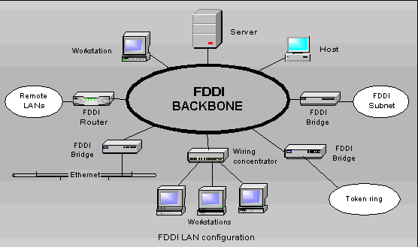
FDDI LAN Configuration

Slide 29
Asynchronous Transfer Mode (ATM)
ATM is a switching technique used by telecommunication networks that uses asynchronous time-division multiplexing to encode data into small, fixed-sized cells.
ATM divides digital data into 53 byte cells and transmits over physical medium.
It is designed to be easily implemented by hardware rather than software.
It creates virtual connection for packet transmission which disappers on completion.

Slide 30
ATM
It provides support for data, video and voice transmissions on one transmission line.
It allows almost unlimited bandwidth on demand.
ATM currently requires fiber optic cable.
It can transmit up to 2.5 gigabits per second.
It is more expensive than ISDN and DSL.

Slide 31
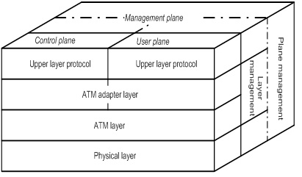
ATM Cell Format

Slide 32
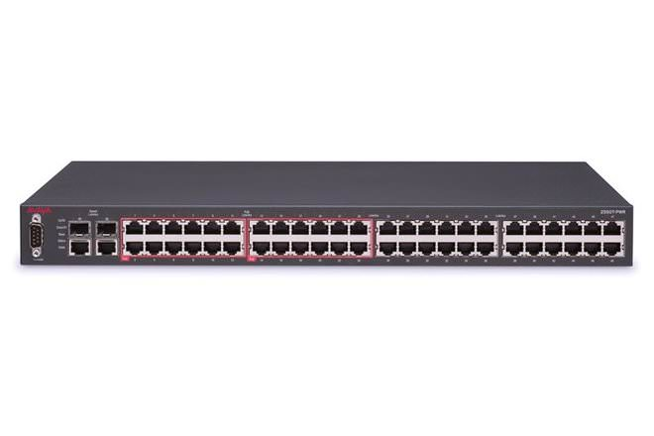
Switched Hub
It is used to boost LAN.
It can turn small LANs into one big LAN.
No need to re-wire or change adapters.
It allows us to add ATM-like packet switching capability to any existing LAN.

Slide 33
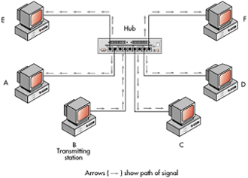

Slide 34
Synchronous Optical Network (SONET)
SONET is an interface standard for transporting digital signal over fiber optic links.
It allows transmission of multiple digital data stream over optical fiber using LASER or LED.
Lower data rates can also be transferred using electrical interfaces.
It defines optical line rates known as OC.
Base rate of OC-1 is 51.84 Mbps.

Slide 35
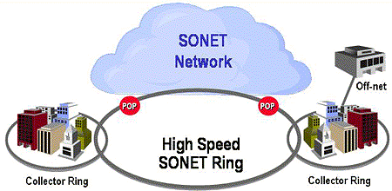
SONET Network

Slide 36
T- Carrier System
It is a digital system that defines circuit that operates at different rates.
This system uses 4 wires and provides duplex capability.
Wires could be twisted pair cable, coaxial cable or optical fiber.
T1 consists of 24 channels each having bandwidth of 64Kbps.
In T1 voice or data is sampled at 8000 samples per second.
Used in Japan and North America.
T1 (24 ch,1.544 Mbps), T2 (96 ch, 6.312 Mbps), T3 (44.736 Mbps, 672 ch)

